Slide 1
Assignment-Discussion POS Tagging Using HMM
23M0837,Ujjwal Sharma, M.Tech 1st year,CSE
23M0753,Swapnil Bhattacharyya,Mtech 1st year, CSE
23M0834, Priyanshu Sharma, M.Tech 1st year, CSE
<Roll No.>,<Year>, <Dept.>

Slide 2
Problem Statement
Given a sequence of words, produce the POS tag sequence
Technique to be used: HMM-Viterbi
Use Universal Tag Set (12 in number)
5-fold cross validation
<list of tags>

Slide 3
Overall performance
Precision : 94.0198283308899
Recall : 93.85240363559173
F-score (3 values)
F1-score :93.8693149901081
F0.5-score : 93.94349573883815
F2-score : 93.84289948874141

Slide 4
Overall performance
Tag:Precision,Recall,F1Score​
‘.’: 0.98,1.00,0.99​
ADJ:0.87,0.89,0.88​
ADP:0.92,0.97,0.94​
ADV:0.90,0.87, 0.88​
CONJ:0.99,0.99,0.99
DET: 0.92,0.99,0.95​
NOUN:0.95,0.92,0.93​
NUM:0.99,0.80,0.88​
PRON:0.93,0.96,0.94​
PRT:0.91, 0.85,0.88​
VERB:0.97,0.92, 0.94​
‘X’: 0.17,0.35,0.23

Slide 5
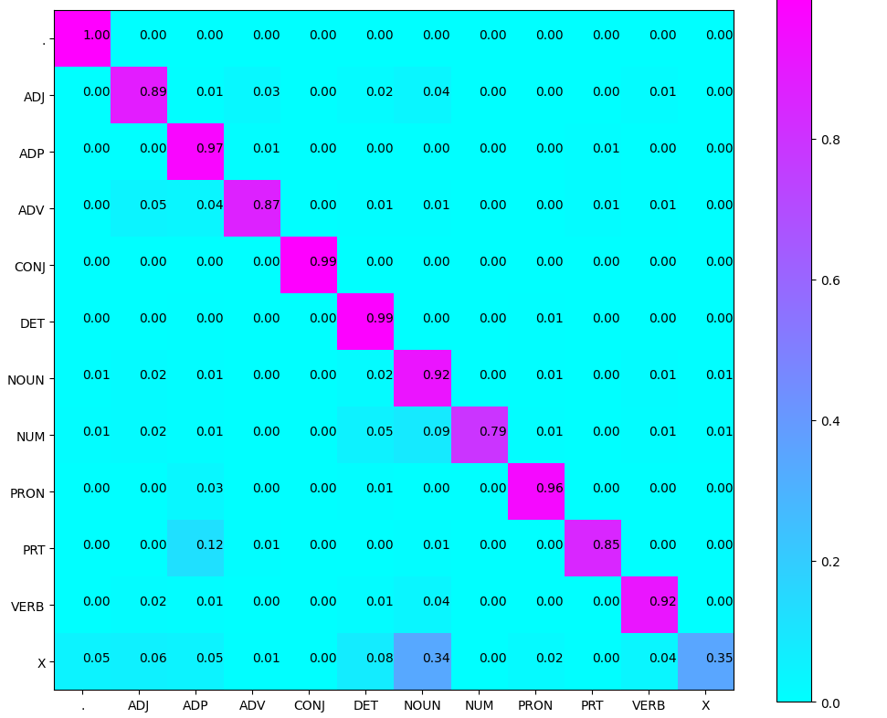
Confusion Matrix (12 X 12) (can give heat map)

Slide 6
Interpretation of confusion (error analysis)
1) The 'PRT' tag is frequently misidentified as the 'ADP' tag, as evidenced by the confusion matrix. The analysis clearly indicates that when 'PRT' is predicted incorrectly, it is usually mislabeled as 'ADP'. Examples of words with the 'PRT' tag include 'on,' 'at,' 'with,' and 'that,' whereas the 'ADP' tag includes words like 'on,' 'at,' 'with,' 'by,' 'into,' and 'of.'
2) Another source of confusion arises between nouns and numerals. For instance, words such as 'sixties' and 'seventies' are often misclassified as nouns. This confusion is exacerbated when dealing with words that blend numericals like '80s' and '90s.'
3) This confusion may stem from the similarities in nature between adpositions and particles, as well as numerals and nouns. Their respective definitions can give a deeper understanding of these linguistic categories.

Slide 7
Example of correctly classified tags :
'He likes to eat chocolates’
['^', 'PRON', 'VERB', 'PRT', 'VERB', 'ADV', ‘$’]
'go NYU for higher studies’
['^', 'VERB', 'NOUN', 'ADP', 'ADJ', 'NOUN', '$’]

Slide 8
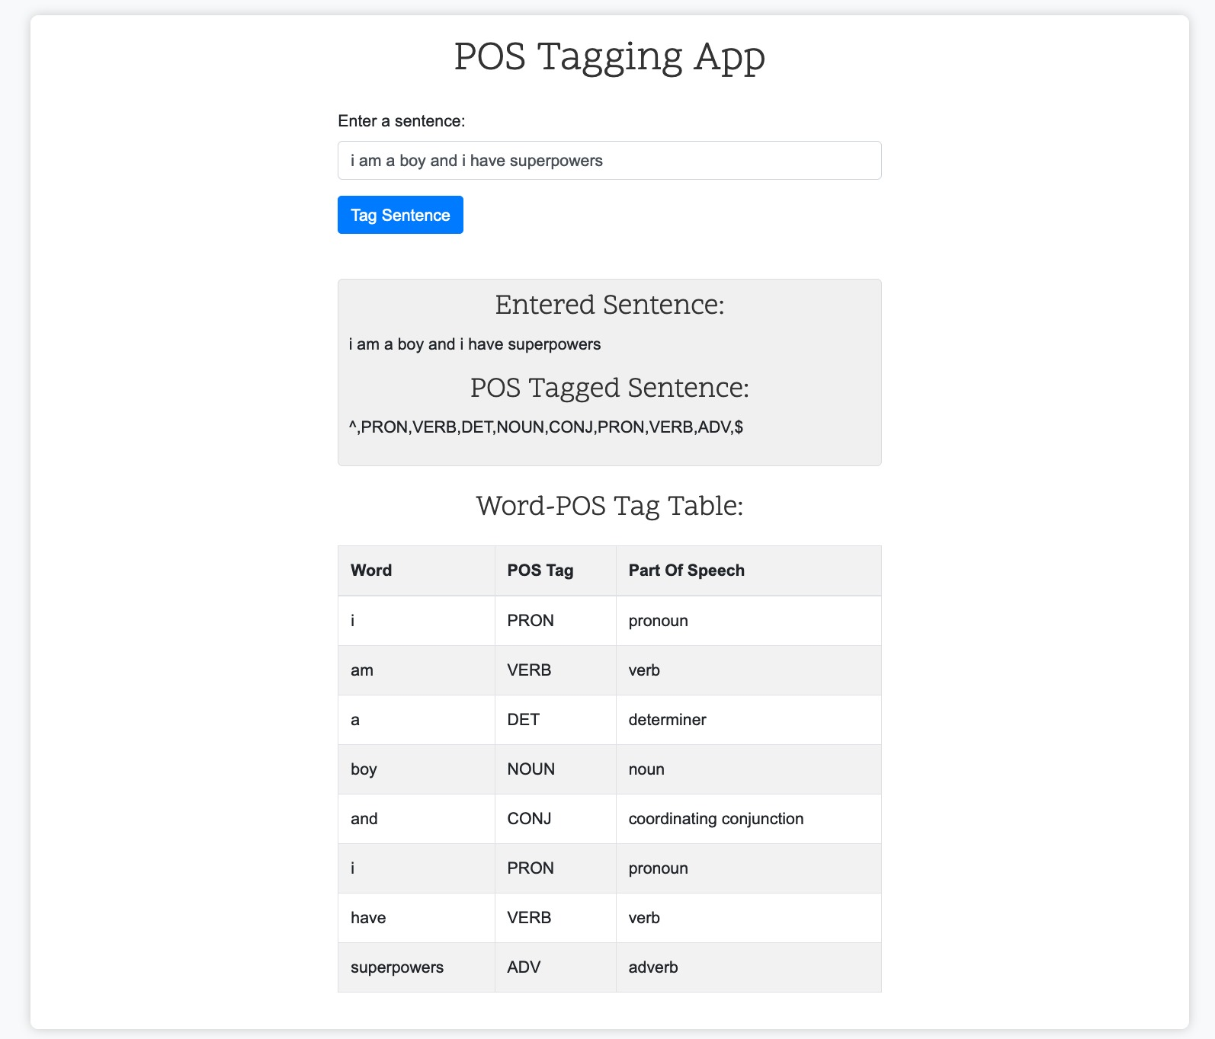
Interface

Slide 9
Examples of incorrectly classified tags :
'judge issues notice’
['^', 'NOUN', 'NOUN', 'VERB', ‘$’]
'judge': Predicted as NOUN (correctly classified)
'issues': Predicted as NOUN (should be a VERB, so misclassified)
'notice': Predicted as VERB (should be a NOUN, so misclassified)
Both "issues" and "notice" can have multiple meanings and functions based on the context in which they are used. These words are polysemous, meaning they have multiple possible meanings. The model may have associated a more common meaning or usage with these words, leading to misclassification.

Slide 10
‘go MIT for higher studies’
'go': Predicted as VERB (should be a VERB, so correctly classified)
‘MIT': Predicted as VERB (should be a NOUN or PROPN, so misclassified)
'for': Predicted as ADP (should be an ADP, so correctly classified)
'higher': Predicted as ADJ (should be an ADJ, so correctly classified)
'studies': Predicted as NOUN (should be a NOUN, so correctly classified)
If “MIT" is a rare word (as opposite to “NYU”) or is not present in the training data, the HMM-based model may struggle to accurately predict its POS tag. Rare or out-of-vocabulary words often pose challenges for statistical models like HMMs. So, If the training data used to train the HMM-based POS tagger does not contain enough instances of the word “MIT" tagged correctly, the model may struggle to accurately assign the correct POS tag.

Slide 11
Data Processing Info (Pre-processing)
1)First we preprocessed the data which included converting the text into lower case and adding ‘^’ as start token and ‘$’ as end token in each sentence.​
2)POS_TAG_COUNTS – stores occurrence of tags in training set​
3) POS_TaggedWords – 2D array with 1st key as word w and 2nd key as tag t and stores no of times word w uses as tag t.​
4)tagTransitionCount – 2D array with 1st key as tag1 & 2nd key as tag2 and stores no of times there is a transition from tag1 to tag2.​
​

Slide 12
Inferencing/Decoding Info
Implemented Viterbi algorithm using the following approach:
i) The "prev" array stores the conditional probability P(word|tag) for the last observed word (i.e., at the previous level).
ii) The "curr" array holds the conditional probability P(word|tag) for the current word, and its values are updated during each iteration. At the end of a level, the data in "curr" is stored in "prev."
iii) The 2-D "parent" array aids in backtracking to determine the best possible tag for each word in the given sentence.
- Backtracking formula:
final_tags[i] = parent[i+1][final_tags[i+1]].
- This helps estimate the tag at the (i)th level based on which tag at the (i+1)th level has the highest probability.
iv) "final_tags" is a list that contains the tags for the given word sequence.
v) Viterbi algorithm is utilized to accurately predict the tags for a given sentence.

Slide 13
Demo
Shown in properly integrated interface

Slide 14
Marking Scheme
1. Demo working- 10/10 (if not, 0)
2. Implemented Viterbi and Clarity on Viterbi- 5/5
3. Transition and Lexical tables clearly described- 5/5
4. Confusion matrix drawn and error analysed- 5/5
5. Overall F-score > 90- 10/10, >80 & <=90- 8/10, else 6/10
6. Unknown word handling- done (5/5; else 0)

Slide 15
Any thoughts on generative vs. discriminative POS tagging
Generative models aim to model the joint probability distribution of words and their corresponding POS tags. One of the most well-known generative models for POS tagging is the Hidden Markov Model (HMM) which we have used.
Discriminative models directly model the conditional probability of POS tags given words. Common discriminative models for POS tagging include Conditional Random Fields (CRFs) and Maximum Entropy Markov Models (MEMMs).

